Slide 1
Table of Contents
This slide deck consists of slides used in 2 lecture videos in Week 4. Below is a list of shortcut hyperlinks for you to jump into specific sections.
(page 2) Week 4: jQuery and the Document Object Model
(page 11) Week 4: Using jQuery
Notes:
Note from Chuck. If you are using these materials, you can remove my name and URL from this replace it with your own, but please retain the CC-BY logo on the first page as well as retain the entire last page when you remix and republish these slides.
TO Highlight – go to https://tohtml.com/html/ - paste and then do a "Paste RTF"

Slide 2

jQuery and the DOM
Dr. Charles Severance
www.dj4e.com
http://www.dj4e.com/code/jquery
http://www.dj4e.com/code/jquery.zip

Slide 3
Vanilla JavaScript (1995)
<script type="text/javascript">
document.write("<p>Hello World</p>")
</script>
https://www.dj4e.com/code/javascript/js-01.htm
http://en.wikipedia.org/wiki/Document_Object_Model

Slide 4

DOM
Browser
Linux
D
O
M
Django
settings.py
Routing
Click
urls.py
views.py
Parse
Response
Views
Templates
forms.py
JavaScript
Database
Shell
Models
model.py
/admin
admin.py

Slide 5
Document Object Model
JavaScript can manipulate the current HTML document.
The “Document Object Model” is how we access various “bits” of the current screen to read and/or manipulate.
We can even find pieces of the model by id attribute and change them.
We can read and write the DOM from (Vanilla) JavaScript.

Slide 6
Using getElementById()
In order not to have to traverse each unique DOM, we use a function call that all browsers support. This allows us to bypass the DOM structure and jump to a particular tag within the DOM and manipulate that tag.

Slide 7
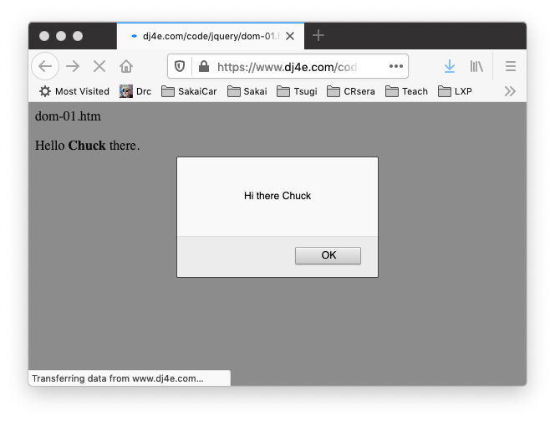
dom-01-htm
<p>
Hello <b><span id="person">Chuck</span></b> there.
</p>
<script type="text/javascript">
console.dir(document.getElementById('person'));
var st = document.getElementById('person').innerHTML;
console.log("ST = "+st);
alert('Hi there ' + st);
document.getElementById('person').innerHTML = 'Joseph';
</script>
dom-01.htm

Slide 8
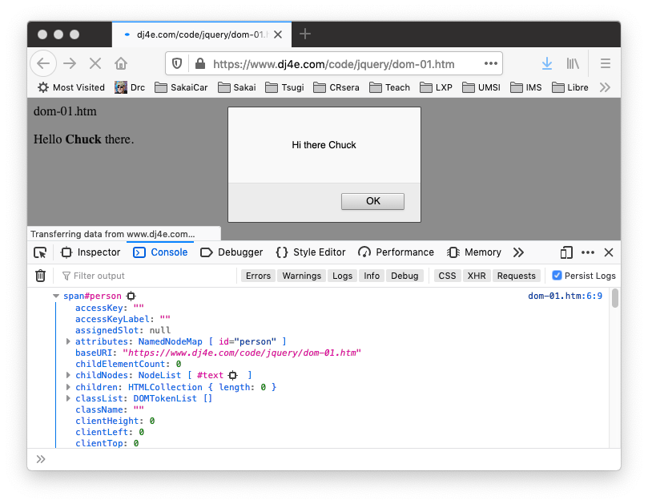
dom-01.htm
dom-01.htm
console.dir(document.getElementById('person'));

Slide 9
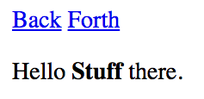
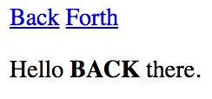
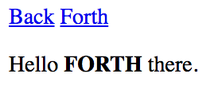
Updating the Browser Document
<a href="#"
onclick="document.getElementById('stuff').innerHTML='BACK';return false;">
Back</a>
<a href="#"
onclick="document.getElementById('stuff').innerHTML='FORTH';return false;">
Forth</a>
</p>
<p>
Hello <b><span id="stuff">Stuff</span></b> there.
dom-02.htm
This is one reason why you can only have one id per document.

Slide 10
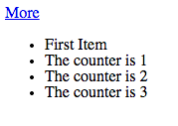
dom-03.htm
<p>
<a href="#" onclick="add();return false;">More</a>
</p>
<ul id="the-list">
<li>First Item</li>
</ul>
<script>
counter = 1;
console.log(document.getElementById('the-list'))
function add() {
var x = document.createElement('li');
x.className = "list-item";
x.innerHTML = "The counter is "+counter;
document.getElementById('the-list').appendChild(x);
counter++;
}
</script>
dom-03.htm

Slide 11
jQuery (2005)

Slide 12
jQuery to the Rescue
While the DOMs are not particularly portable, and direct DOM manipulation is a little clunky, there are a number of JavaScript frameworks that handle the myriad of subtle differences between browsers.
With jQuery, instead of manipulating the DOM, we use jQuery functions and everything works much better...
http://jquery.org

Slide 13
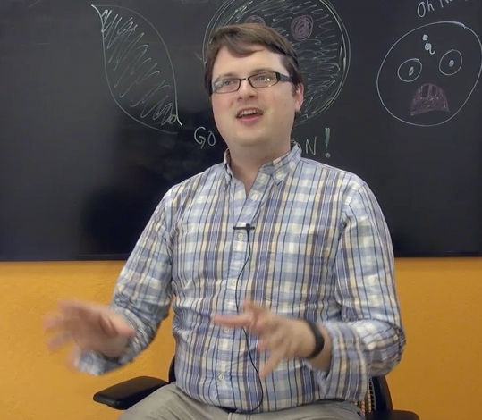
John Resig
Started jQuery in 2005 to make his web development projects easier
Elegant way to select DOM elements
Clean way to register events
Released in 2006
Works at Khan Academy as the “Dean of Computer Science”

Slide 14
jQuery Documentation
The web is a wonderful source of jQuery documentation.
http://docs.jquery.com/Main_Page
http://api.jquery.com/
http://jqueryui.com/demos/
This lecture will only cover the basic elements of low-level jQuery.

Slide 15
jquery/jq-01.htm
<html>
<head>
</head>
<body>
<p>Here is some awesome page content</p>
<script type="text/javascript" src="jquery.min.js">
</script>
<script type="text/javascript">
$(document).ready(function(){
alert("Hello jQuery World!");
console.log('Hello jQuery..');
});
</script>
</body>
jquery/jq-01.htm

Slide 16
jquery/jq-02.htm
<html
<head>
</head>
<body>
<script type="text/javascript" src="jquery.min.js">
</script>
<script type="text/javascript">
$(window).resize(function() {
console.log('.resize() called. width='+
$(window).width()+' height='+$(window).height());
});
</script>
<p>Here is some awesome page content</p>
</body>
jquery/jq-02.htm
http://api.jquery.com/resize/

Slide 17
jquery/jq-03.htm
jquery/jq-03.htm
<p id="para">Where is the spinner?
<img id="spinner" src="spinner.gif" height="25"
style="vertical-align: middle; display:none;">
</p><p>
<a href="#" id="tog">Toggle</a> |
<a href="#" id="red">Red</a>
</p>
<script type="text/javascript">
$(document).ready(function() {
$("#tog").on('click', function() {
$('#spinner').toggle();
});
$("#red").on('click', function() {
$('#para').css('background-color', 'green');
});
});
</script>
Where is the spinner?
Toggle | Red
Where is the spinner?
Toggle | Red
Where is the spinner?
Toggle | Red

Slide 18
jq-04.htm
<p>
<a href="#" id="the-href">More</a>
</p>
<ul id="the-list">
<li>First Item</li>
</ul>
<script type="text/javascript"
src="jquery.min.js"> </script>
<script>
counter = 1;
$(document).ready(function(){
$("#the-href").on('click', function() {
console.log('Clicked');
$('#the-list').append('<li>The counter is '+counter+'</li>');
counter++;
});
});
</script>
jq-04.htm

Slide 19
Improving Browsers…
jQuery is now > 15 years old – many people assume it is JavaScript
The browsers have been extending the DOM in a portable fashion and adding features equivalent to jQuery
// jQuery: Hide all instances with class box
$(".box").hide();
// Vanilla: Iterate over the nodelist of elements to hide all instances of .box
document.querySelectorAll(".box").forEach(box => { box.style.display = "none" }
https://tobiasahlin.com/blog/move-from-jquery-to-vanilla-javascript/

Slide 20
Summary
This focused on the mechanics of low-level jQuery.
Initialization setup
Event handling
DOM selection
DOM manipulation
Vanilla JavaScript is catching up…

Slide 21
Acknowledgements / Contributions
These slides are Copyright 2010- Charles R. Severance (www.dr-chuck.com) as part of www.dj4e.com and made available under a Creative Commons Attribution 4.0 License. Please maintain this last slide in all copies of the document to comply with the attribution requirements of the license. If you make a change, feel free to add your name and organization to the list of contributors on this page as you republish the materials.
Initial Development: Charles Severance, University of Michigan School of Information
Insert new Contributors and Translators here including names and dates
Continue new Contributors and Translators here
Notes:
Note from Chuck. Please retain and maintain this page as you remix and republish these materials. Please add any of your own improvements or contributions.

Slide 22
Additional Source Information
Image of John Resig Copyright Charles R. Severance and licensed as CC-BY

